Slide 1


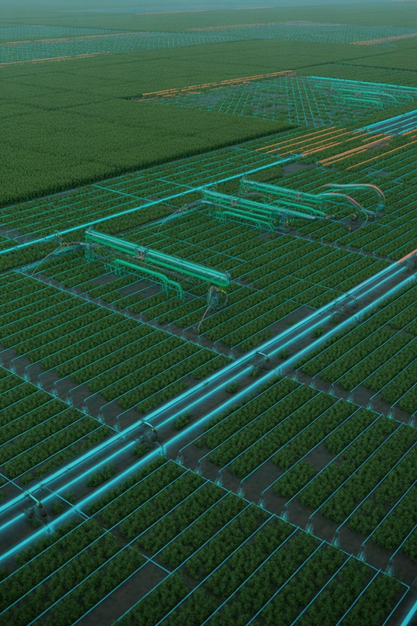

Causal Impact of Micro-Irrigation on Groundwater Depletion in India
A Causal Machine Learning Approach
Presented by: Senior Data Scientist
Institution: Research Institute of Technology Date: October 26, 2023

Slide 2




The Crisis: Groundwater Depletion in India
Indiafaces asevere groundwaterdepletion crisis,critical for agriculturalsustenance. Agriculture, heavily reliant on irrigation, is a primary driver of this depletion. Micro-irrigation techniques offer a potential solution through efficient water use.
Stressed Aquifers
Rapidly declining water tables across key agricultural regions.
Agricultural Burden
Over 80% of groundwater extraction is for irrigation.
Sustainable Solutions
Micro-irrigation for optimised water management.

Slide 3
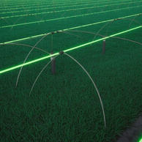


Motivation & Importance
Environme ntal Sustainabil ity
Mitigatingecological damage and preserving natural resources.
Farmer Income & Water Efficiency
Policy Relevance
Informingeffective
government subsidy programmes for micro- irrigation adoption.
Enhancingcrop yields
with less water, boosting farmer livelihoods.

Slide 4


Does Micro-Irrigation Causally Reduce Groundwater Depletion?
Our core research question investigates the direct causal effect of micro-irrigation adoption.
Traditional correlational studies are
insufficient due to confounding factors.
Causal inference is crucial for valid policy
recommendations and understanding true
impact.
High Correlation
Ice Cream Sales ↑ vs.
Micro-irrigation Adoption ↑ and
Drowning ↑
Groundwater Decline?
Low
High
Causation
Causation
Fertilizer Use ↑ → Crop
Summer Temperature ↑
Yield ↑
(Confounder)
Why correlation is NOT causality.
Low Correlation

Slide 5

Dataset Overview
Utilising a comprehensive panel dataset to capture spatio-temporal dynamics.
Panel Data: Observations over
multiple regions and time periods.
Regions & Time: Spanning key
agricultural states of India from 2000-
2020.
Key variables include treatment status
(micro-irrigation adoption), outcome
(groundwater levels), and various control
variables.

Slide 6

Key Challenges in Causal Inference
Selection Bias
Confounding Variables
Reverse Causality
Depleting groundwatermight
Farmersadoptingmicro-irrigationmay
not be randomly selected.
Factorsinfluencing bothtreatment and outcome (e.g., rainfall, soil type).
encourage micro-irrigation adoption.
Addressing these challenges is paramount for robust causal effect estimation.

Slide 7


Methodology Overview: Causal Machine Learning
Data
Pre- process ing
Causal ML
Impact Estimat ion
Collecti on
Our approach integrates advanced machine learning with econometric principles to identify causal effects, moving beyond traditional statistical methods to robustly estimate impact.

Slide 8
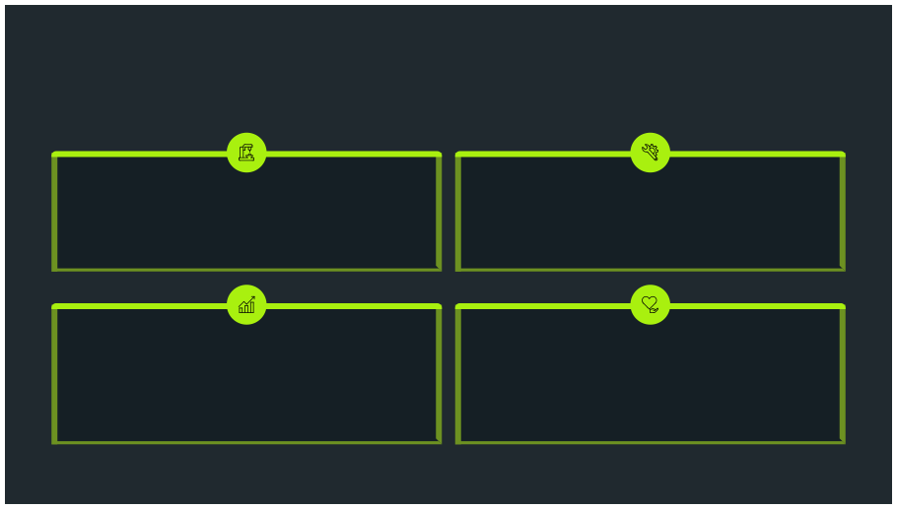
Causal Techniques Utilised
Double Machine Learning (DML)
Fixed Effects
Controlsforunobservedtime-invariant confounders.
Minimises regularisation bias from high-dimensional controls.
Clustering & Robust Standard Errors
Sensitivity Analysis
Assesses robustness of results to unobserved confounding.
Accountsforcorrelationwithinclusters(e.g.,districts) and
heteroscedasticity.

Slide 9
Model Architecture
The Double Machine Learning framework employs two distinct models:
Cross- Fitting
Treatmen t Model
Treatment Model: Predicts
treatment status (micro-irrigation
adoption) based on covariates.
Outcome Model: Predicts
groundwater depletion based on
covariates.
Overarching sample-
Predicts treatment
splitting process
Doubl
from covariates
e Machi ne Learni ng
Causal
Effect Estimatio n
Combines model
Outcome Model
Cross-fitting ensures unbiased estimation
by preventing overfitting.
Predicts outcome from
covariates
residuals

